Slide 1
Identifying and Finding the
Exo planet
Mentored by
Dr. Narayana darapaneni
PGPAIML Nov’18 Capstone Project - Group 5
Jeyakumar, Kumaran, Mahendran, Rajan and Varun

Slide 2


Slide 3
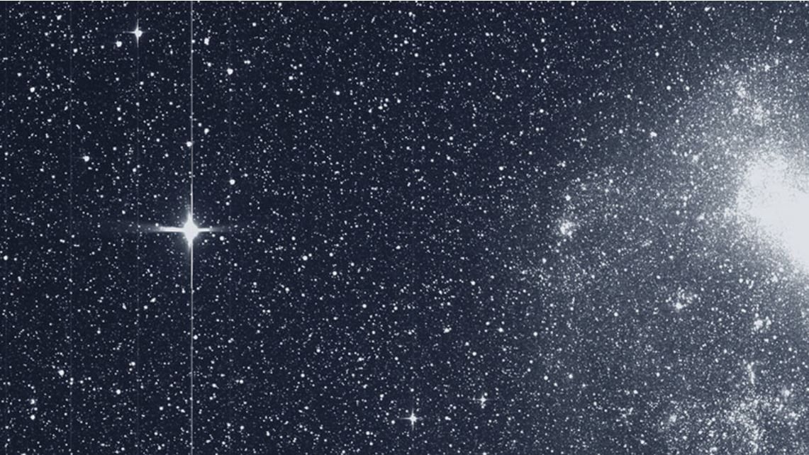
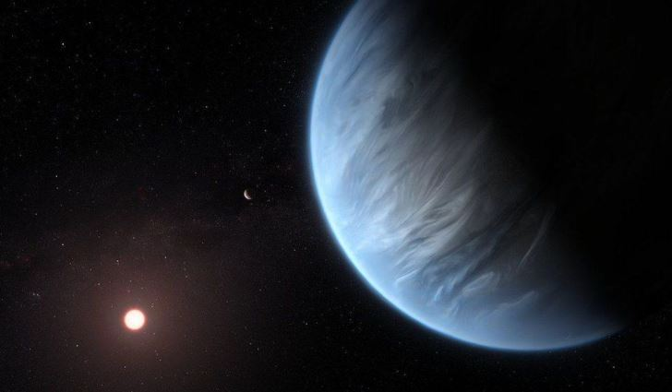
Problem Statement
Identifying the Exoplanets using light intensity

Slide 4
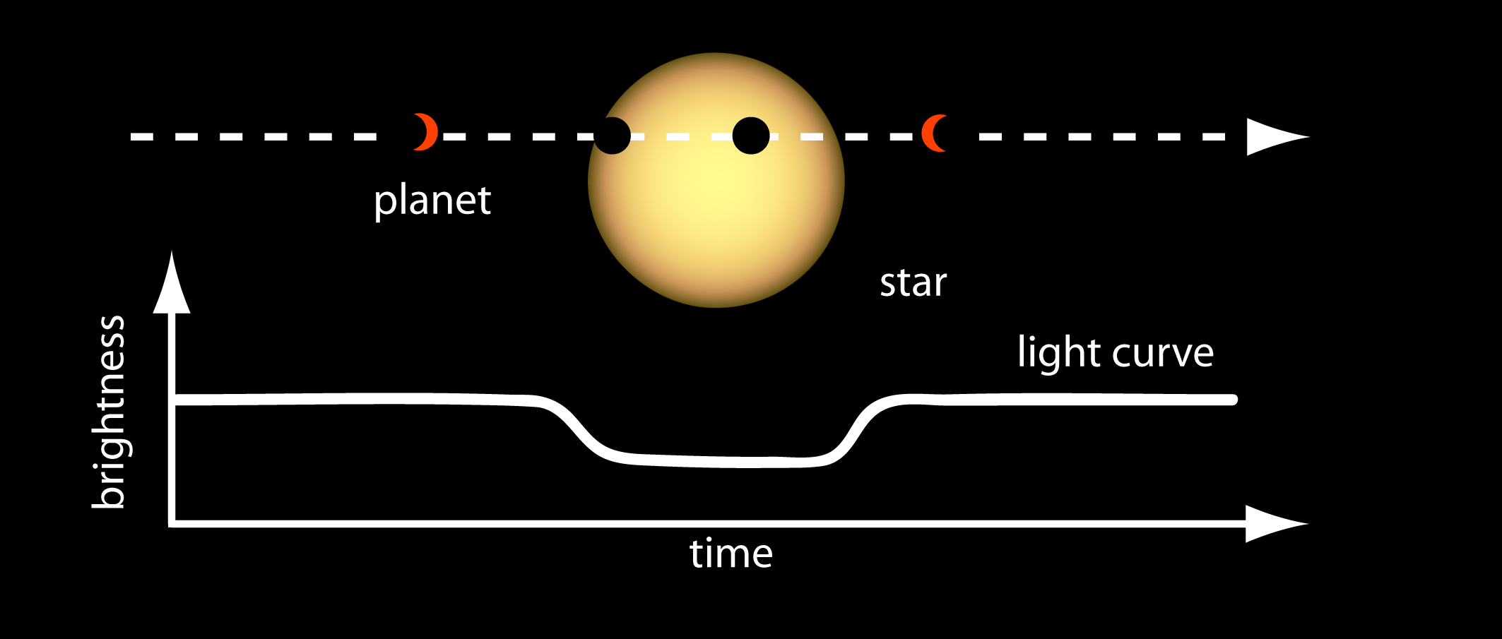
Light Intensity
Light intensity refers to the strength or amount of light produced by a specific lamp source. It is the measure of the wavelength-weighted power emitted by a light source.

Slide 5
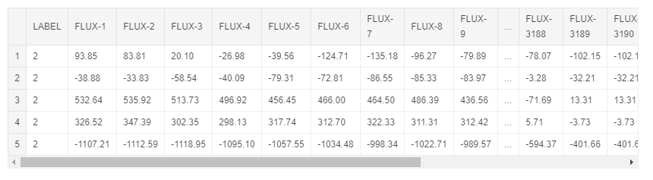
About Data
Observations made by the NASA Kepler space telescope
Data describe the change in flux (light intensity) of several thousand stars

Slide 6
Train and Test Data
Trainset:
5087 rows or observations.
3198 columns or features.
Column 1 is the label vector. Columns 2 - 3198 are the flux values over time.
37 confirmed exoplanet-stars and 5050 non-exoplanet-stars.
Testset:
570 rows or observations.
3198 columns or features.
Column 1 is the label vector. Columns 2 - 3198 are the flux values over time.
5 confirmed exoplanet-stars and 565 non-exoplanet-stars.

Slide 7
Exploratory Data Analysis
3198 independent features
Independent variables represent light luminosity values.
No string/object types - all values are of float type so no need for data type conversion.
No null / missing values.

Slide 8

Which model gives high accuracy?
We have used below models
Random Forest
Decision Tree
Naïve Bayes
XG Boosting
ADA Boosting
CNN With Adam Optimizer
CNN with SGD Optimizer
CNN with SGD Optimizer, Learning Rate and Momentum

Slide 9
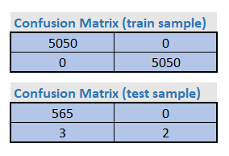
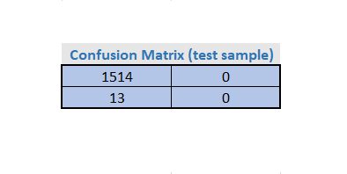
What Model Says?
SGD Classifier
  Accuracy 99%
  Precision 99%
Decision Tree
  Accuracy 99%
  Precision 99%
Random Forest
  Accuracy 99%
  Precision 99%

Slide 10
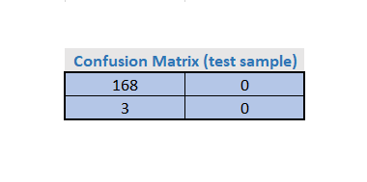
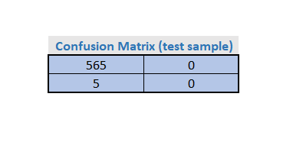
What Model Says?
Naïve Bayes
  Accuracy 99.52%
  Precision 99%
ADA Boost
  Accuracy 99%
  Precision 99%

Slide 11
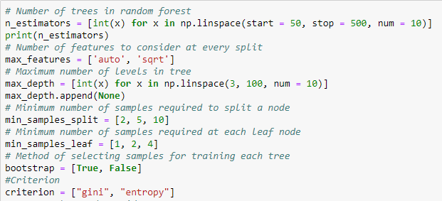
Hyper Parameters for Random Forest

Slide 12
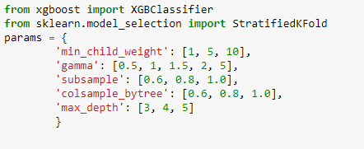
Hyper Parameters for XG Boosting

Slide 13
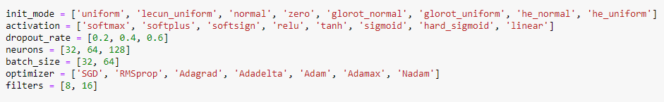
Hyper Parameters for CNN

Slide 14
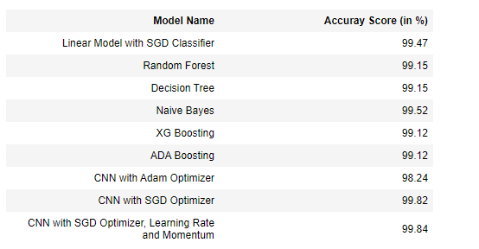
Model Evaluation

Slide 15
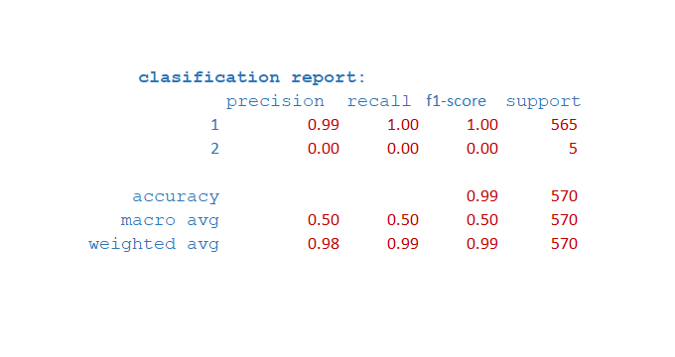
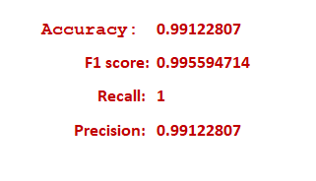
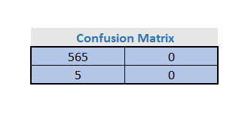
What happens with AUTOML?

Slide 16
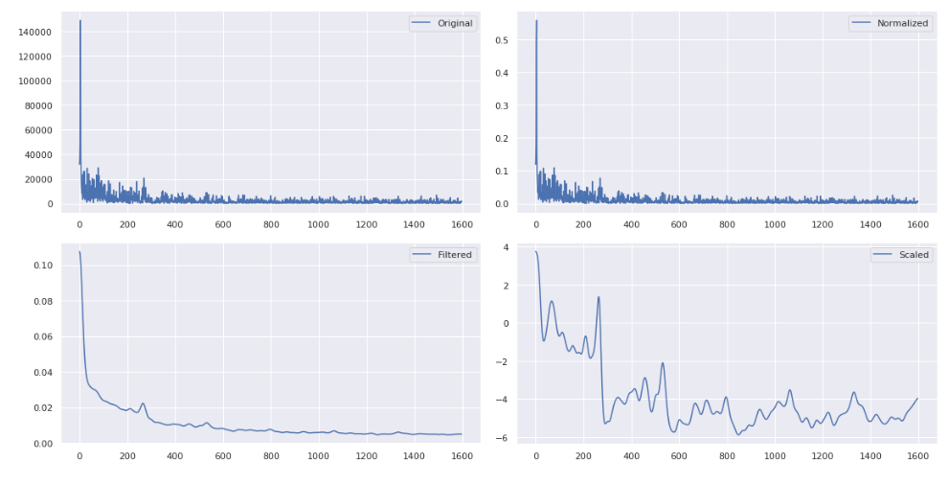
Visualization

Slide 17
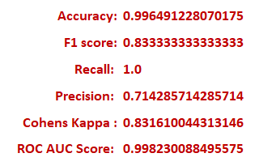
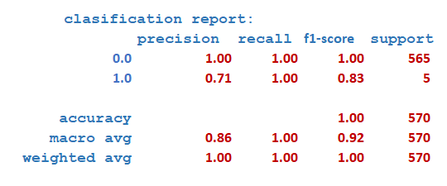

CNN Conv 1D

Slide 18

And the solution…
CNN Conv 1D
  Used Optimizer as SGD gives good result
  Look up confusion matrix with correct predictions

Slide 19
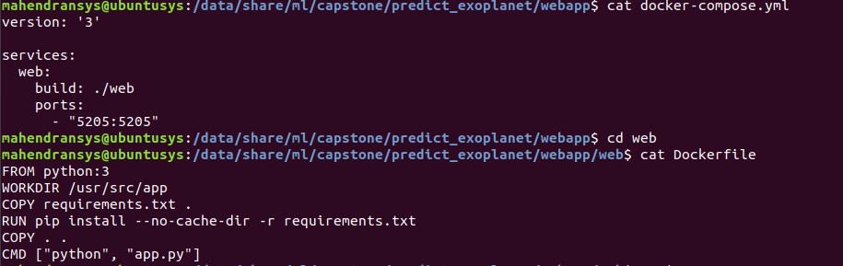
Containerized Flask Web app

Slide 20
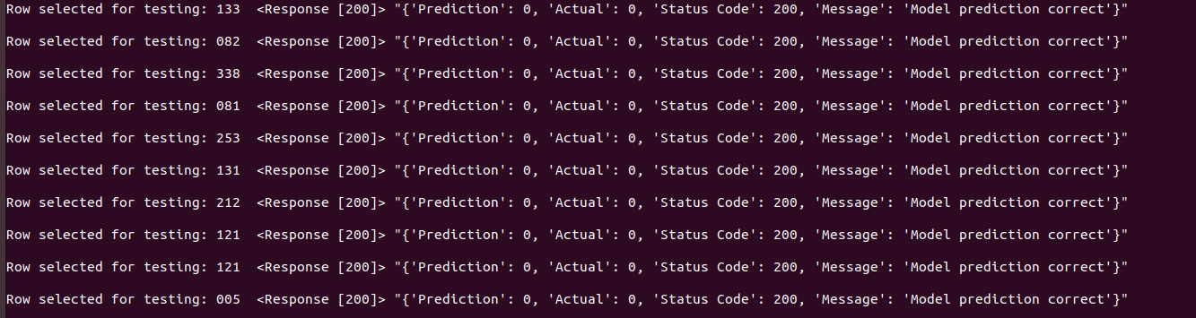
Google Cloud Flask Webapp Demo

Slide 21

Conclusion
Model One – Base Model
  Uses CNN Conv1D with max pooling, batch norm, fixed kernel and filter size and drop out, dense layers with Relu for non-linearity in hidden layers and Sigmoid in the final dense layer, Adam optimizer with fixed learning rate using accuracy, f1, precision, recall as metrics functions.
Model Two
  Similar to Model one except for optimizer as SGD.
Model Three
  It is similar to Model two except for using learning rate and momentum in SGD
Conclusion
  Among these 3 models with preset parameters - we see model two performance is good. Beyond these preset models we use SMOTE for data sampling to balance the data set and Keras Classifier with Randomized Search CV for model and hyper parameter tuning.

Slide 22


Slide 23
Thank you!

